Slide 1
TRAVEL INSURANCE ANALYSIS
BRIAN MUNGAI (DATA VISUALIST)

Slide 2


AGENDA
INTRODUCTION
PRIMARY GOALS
ANALYSIS
SUMMARY

Slide 3

INTRO
Welcome to Brimer Travel Insurance Department, your trusted partner in providing comprehensive and reliable travel insurance solutions. At Brimer Travel Insurance, we understand that every journey is a unique adventure, and ensuring your peace of mind throughout your travels is our top priority.

Slide 4
PRIMARY GOALS
Having a well and better informed travel insurance information.

Slide 5
What does our typical customer look like?

Slide 6
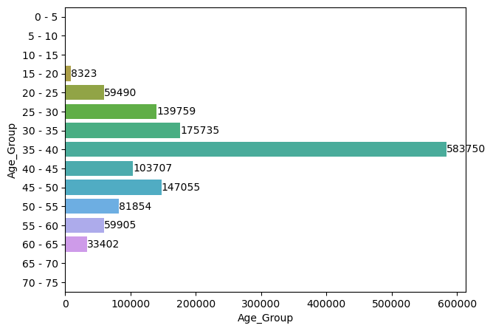
AGE GROUP OF CLIENTS
It can be noted that more than 50% of clients are aged between 35-40 years of age.
We can conclude the average age of customer that uses insurance are 38 or close to 40 years old.

Slide 7
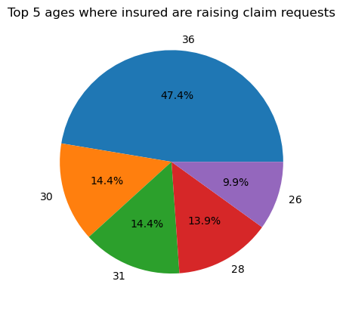
ages where insured are raising claim requests
Top 3 ages that claimed the insurance are:
1.36 years with 47.4%
2.30 years with 14.9%
3.31 years with 14.4%
This is only based on the age and not on gender with others.
It can be noted the 25-30 age group has a significant high number of claim requests.

Slide 8
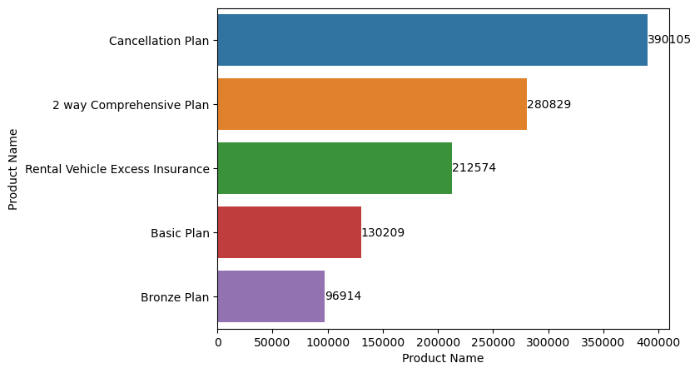
Highest SOLD INSURANCE PLANS
A total of 1,310,175 insurance plans were sold in the year.
Cancellation plan had the highest sale of 390,105.

Slide 9
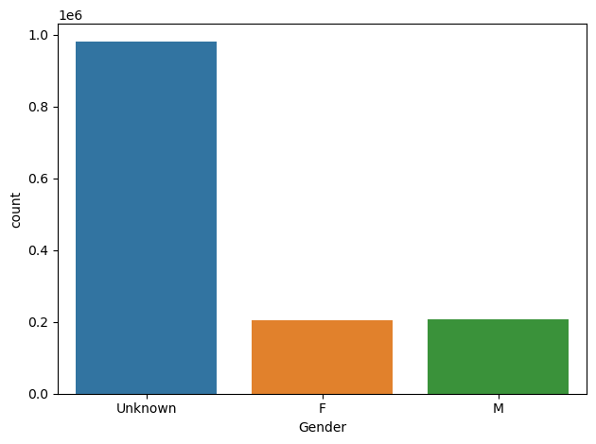
Gender based analysis
As per the data provided, a conclusion could not be made based on Gender.
It is good to note that for the Gender that was recorded, the number of males and females were more or less the same

Slide 10
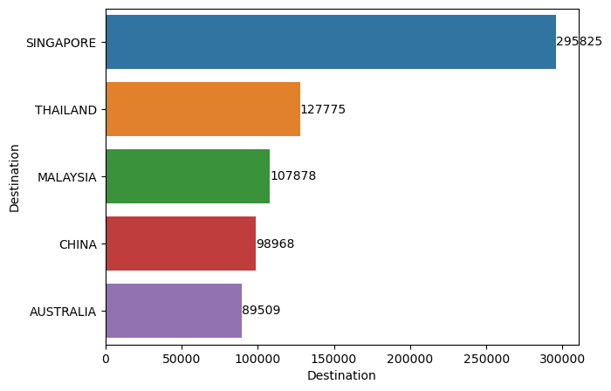
Top 5 visited countries
A total of 147 countries were visited during the year.
Singapore stood out with a significant margin.

Slide 11
what are our high income insurance plans?
Best sales insurance product vs Highest profit insurance product

Slide 12
Highest SOLD INSURANCE PLANS
A total of 1,310,175 insurance plans were sold in the year.
Cancellation plan had the highest sale of 390,105.

Slide 13
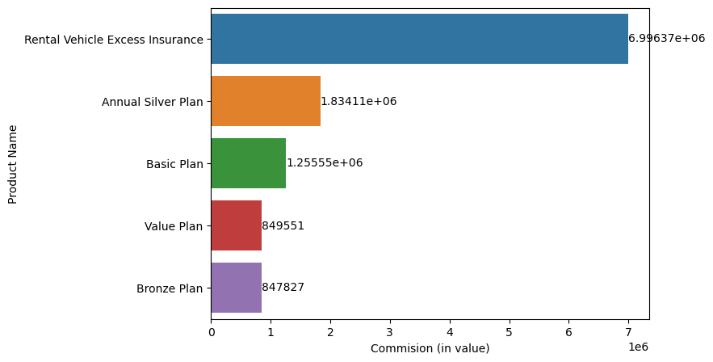
Highest profit plans
Despite Cancellation plan being the most sold, it didn’t manage to be among the top 5 highest profit plan.

Slide 14
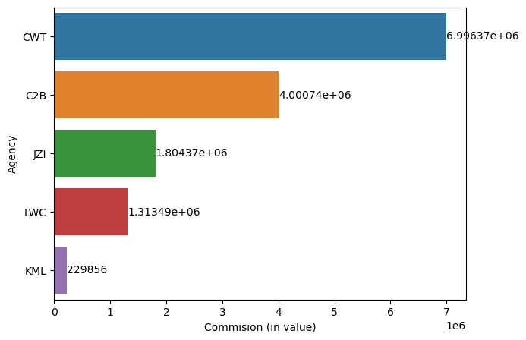
Highest performing agencies
Majority of the clients preferred using CWT agency.
Can be concluded that CWT, C2B JZI & LWC are the top agencies used by majority of the clients.

Slide 15
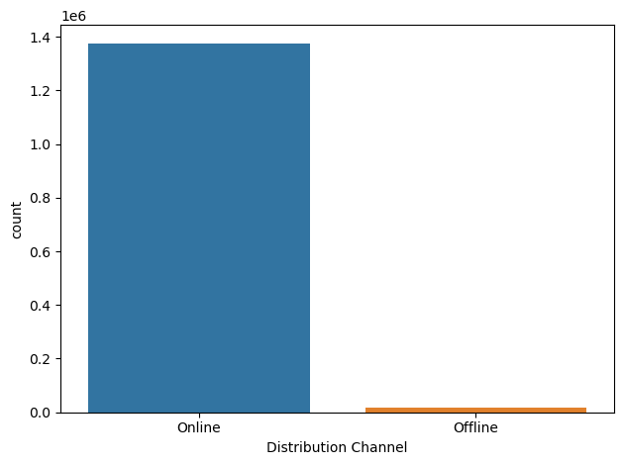
DISTRIBUTION CHANNELS
It can be concluded that more than 85% our clients preferred online distribution channels

Slide 16
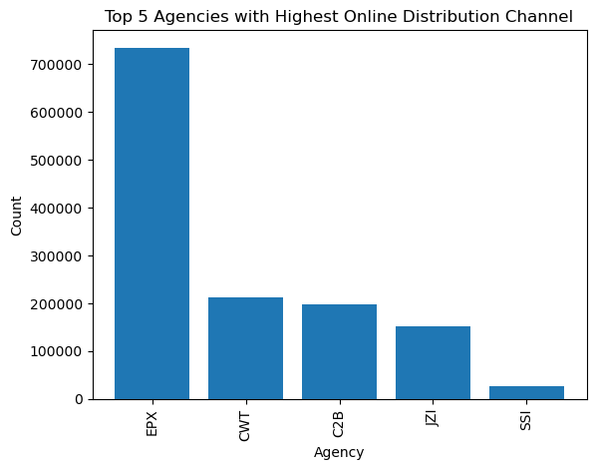
AGENCIES WITH ONLINE DISTRIBUTION
It can be noted that the CWT agency didn’t fully utilize the online distribution being the leading agency when it comes to commissions.

Slide 17
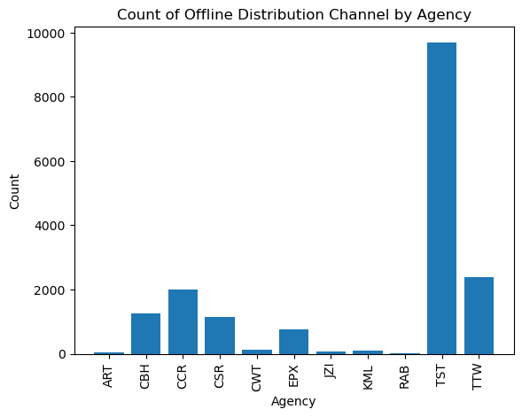
AGENCIES WITH Offline DISTRIBUTION
It can be noted how the offline has a significant lower count than the online distribution channels

Slide 18



WHAT ARE OUR CLAIM REQUESTS ANALYSIS?

Slide 19
AGE CLAIM REQUEST

Slide 20
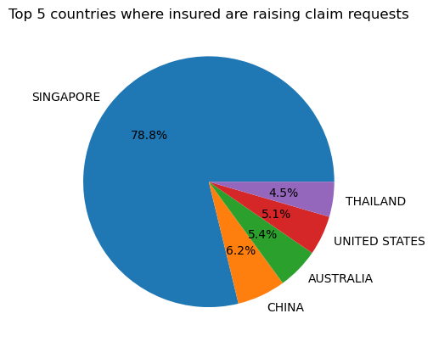
COUNTRIES CLAIM REQUESTS
It can be noted that some countries that were not top 5 visited report high amount of claim requests.

Slide 21
Analysis of claims by gender factor could not be done due to the high number of unknown in the records.

Slide 22
BUSINESS OPPORTUNITIES ARE LIKE BUSES. THERE'S ALWAYS ANOTHER ONE COMING.
“
”
Richard Branson

Slide 23
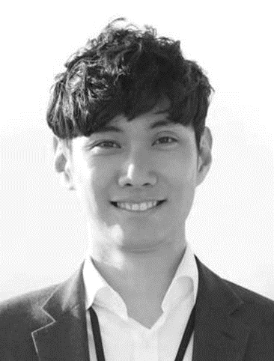
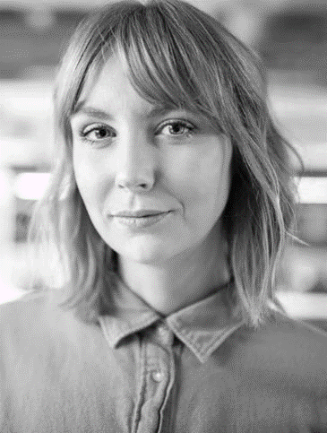
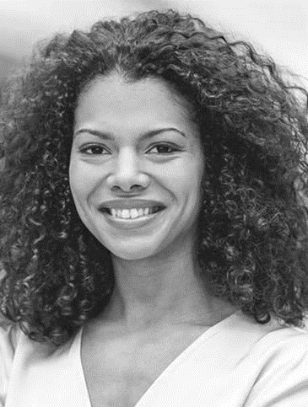
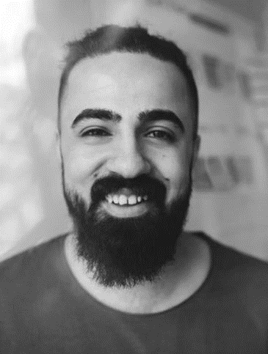
MEET OUR TEAM
Takuma
Hayashi
Mirjam
Nilsson
Flora
Berggren
Rajesh Santoshi
President
Chief Executive Officer
Chief Operations Officer
VP Marketing

Slide 24
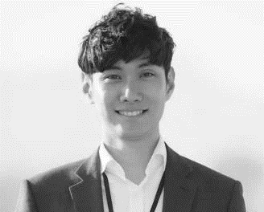


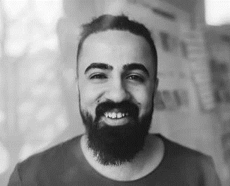




MEET OUR EXTENDED TEAM
Takuma Hayashi
Mirjam Nilsson
Flora Berggren
Rajesh Santoshi
President
Chief Executive Officer
Chief Operations Officer
VP Marketing
Graham Barnes
Rowan Murphy
Elizabeth Moore
Robin Kline
VP Product
SEO Strategist
Product Designer
Content Developer

Slide 25

SUMMARY & Conclusions
Majority of the insured are aged between 35-40.
Review of the insurance plans prices should be done to ensure consistency in sales and profit.
Further investments can be done in the offline distribution to attract more clients.
More research can be done regarding Singapore and its high cases of claims and appropriate actions taken.

Slide 26
THANK YOU
Brian Mungai Mwangi
brian.mungai@student.moringaschool.com
Brimer Insurance LTD

